Slide 1

Advance organizer
Learning objectives:
Understand 3.3 Solving Systems of Inequalities
Prior knowledge:
Understand 2.8 Two-Variable Inequalities
Successful criteria:
Controlled Practice: Complete the Exit Card
Freer Practice: Complete questions to your interest
Learning activities:
1. Preview and Vocabulary Check (10 minutes):
Quickly scan through the text and noting any unfamiliar terms.
2. Comprehend the Presentation (45 minutes):
3. Exit Card Completion (25 minutes):
4. Main Idea Summary and Reflection (5 minute):

Slide 2
Key terms:
Systems of Equations (方程组): A set of multiple equations that are considered together, typically involving several variables. The goal when working with systems of equations is to find values for the variables that satisfy all the equations simultaneously.
Systems of Inequalities (不等式组): A collection of multiple inequality statements involving several variables. Similar to systems of equations, the aim is to find values for the variables that satisfy all the inequalities at once.
Substitution (替代法): In mathematics, substitution is a method used to solve a system of equations by replacing one variable with an expression in terms of the other variables.
Elimination (消元法): Elimination is another method for solving systems of equations. It involves adding or subtracting equations in a system to eliminate one of the variables, making it easier to solve for the remaining variables.

Slide 3
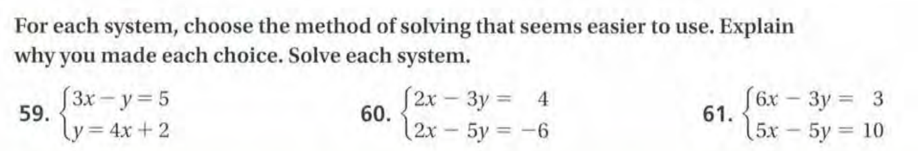
Solving Systems of Equations using Substitution or Elimination

Slide 4
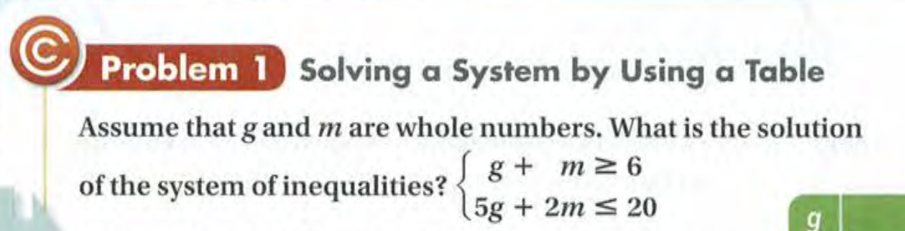
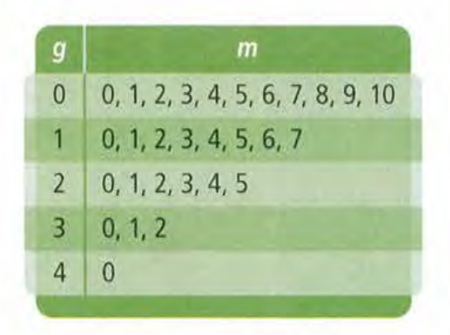

Slide 5
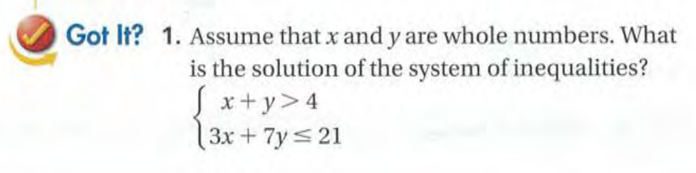

Slide 6
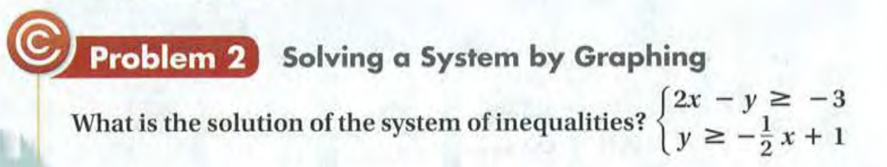
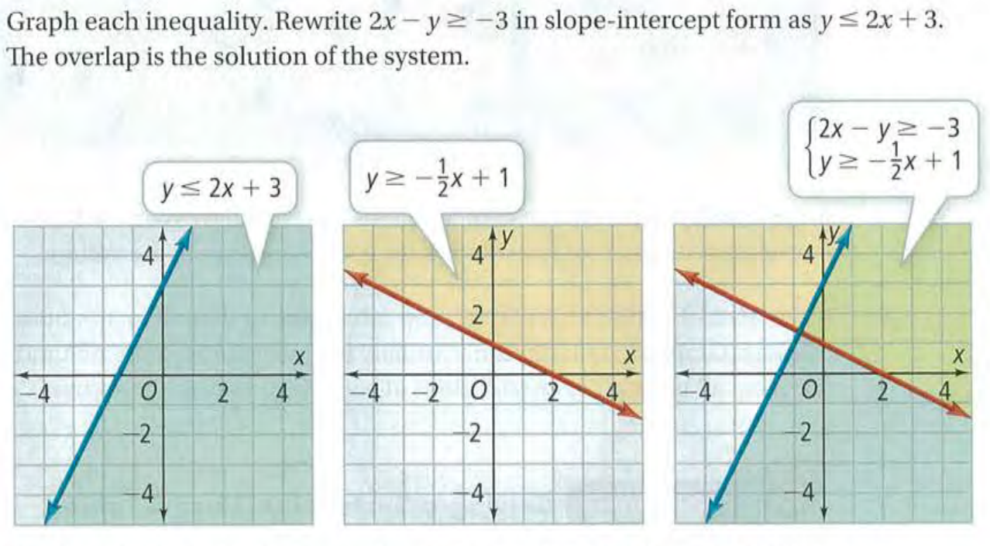
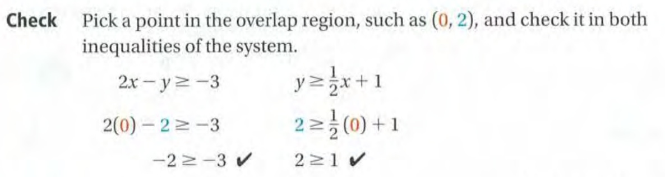

Slide 7
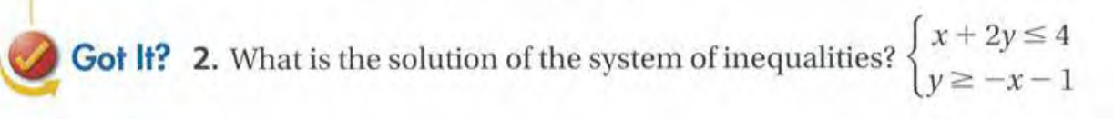

Slide 8
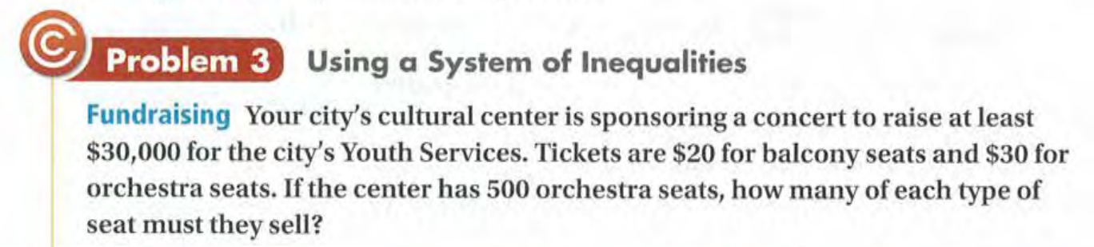

Slide 9
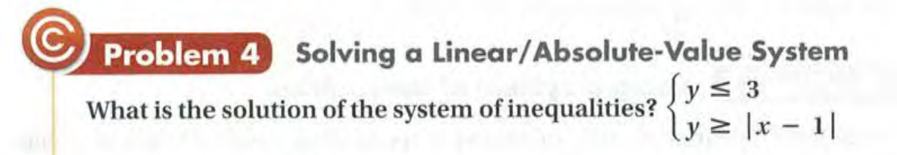
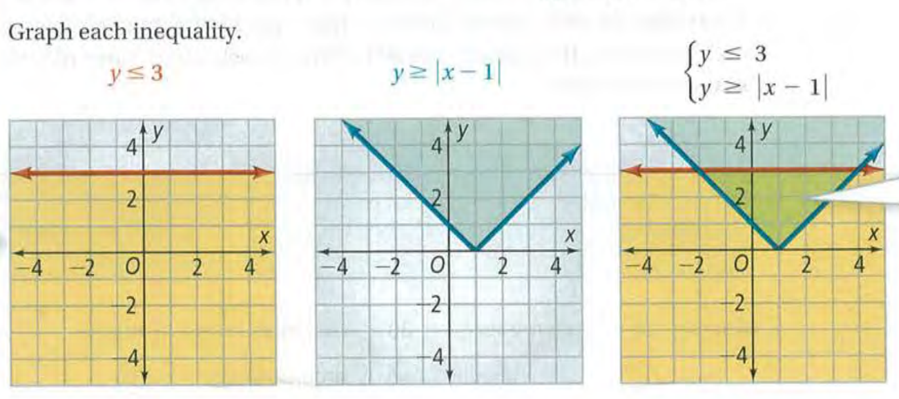

Slide 10
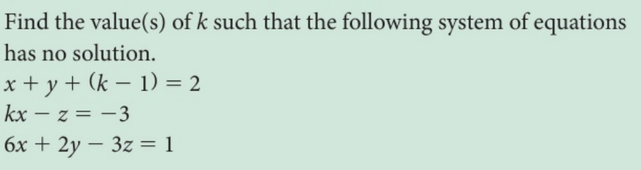
Back Burning Question!

Slide 11
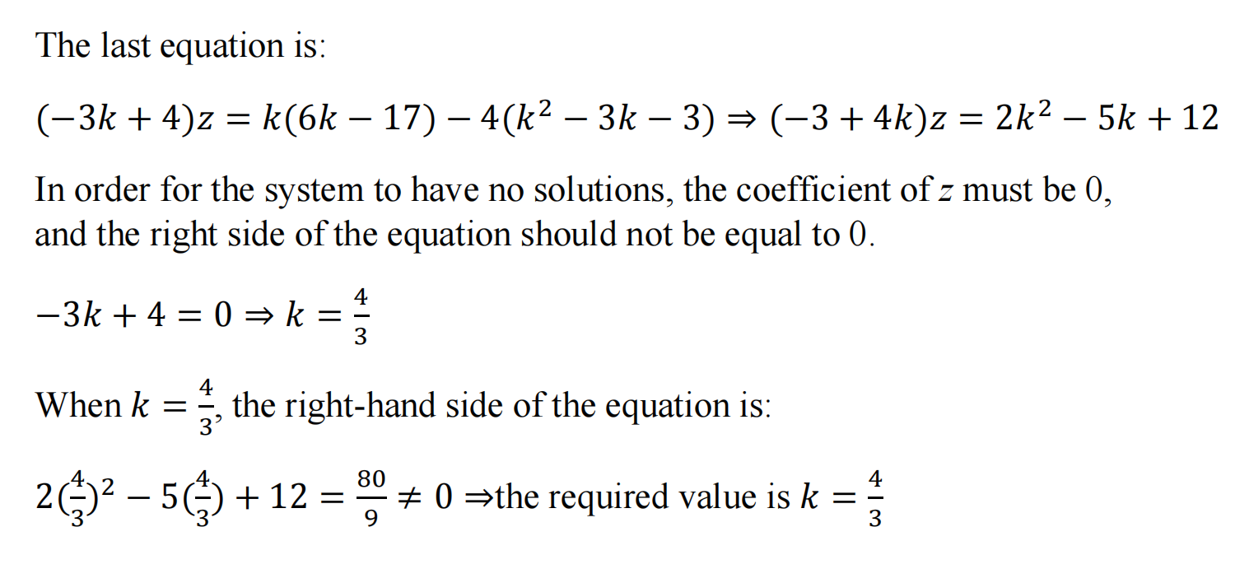
Solution:

Slide 12
Exit Card:
Complete the learning sheet!

